Slide 1


ECEN 403
Team #44
Cubesat EM Material Discharge Eval:
Joshua Feldman
Michael Kim
Ian Poynter
Alejandro Torres
Sponsor: Orbital Arc & SATOP
TA: Peng-Hao Huang

Slide 2
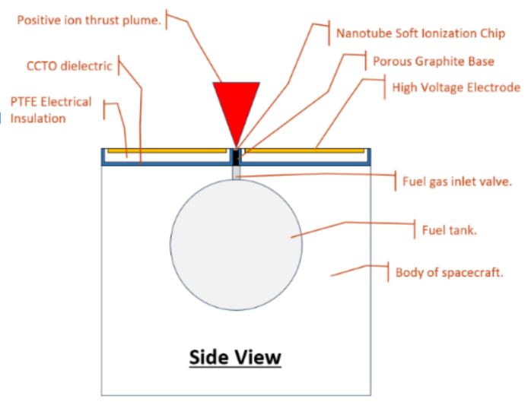
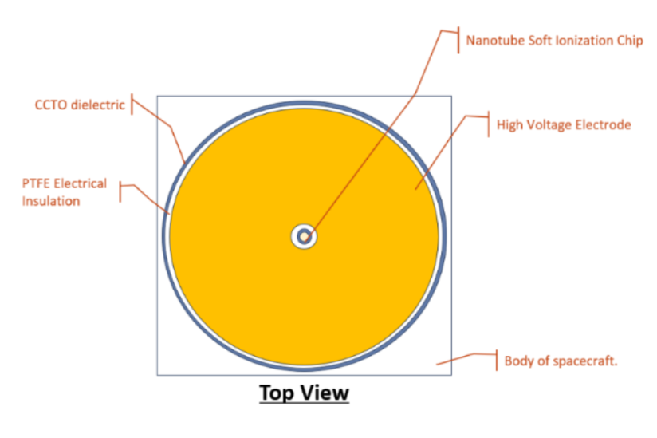
RIOT Drive
Construction of the first prototype for the RIOT Drive by Orbital Arc
Accelerator Plate Data
Microcontroller System
Power Supply Circuitry
Chassis Design

Slide 3
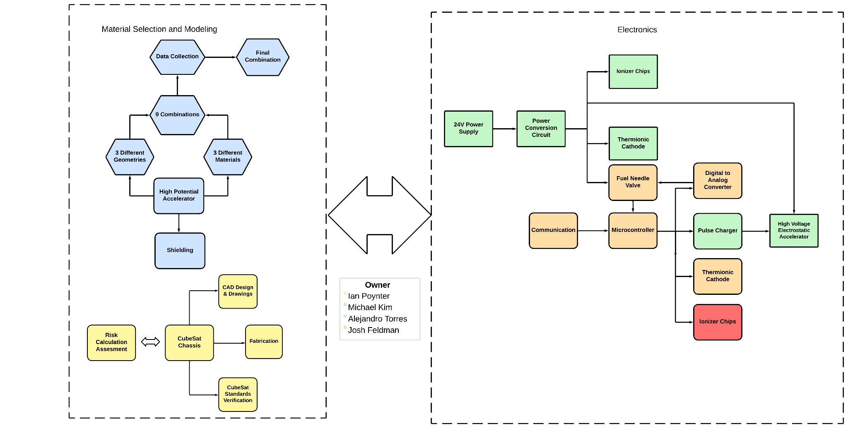
System Block Diagram

Slide 4
Power Supply Circuit Accomplishments
Simulations for buck and boost converter
PCB design completed in Altium
All parts for PCB ordered
PCB assembled
Buck converter working

Slide 5
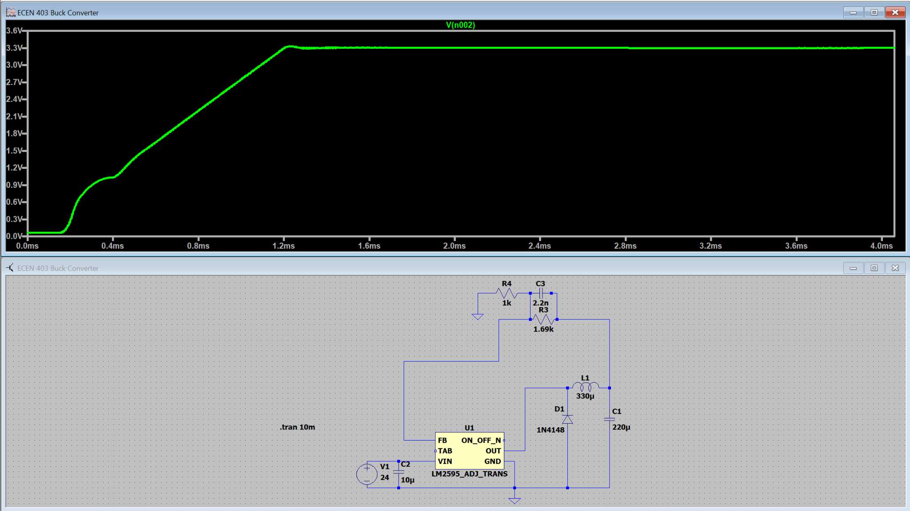
Buck Converter

Slide 6
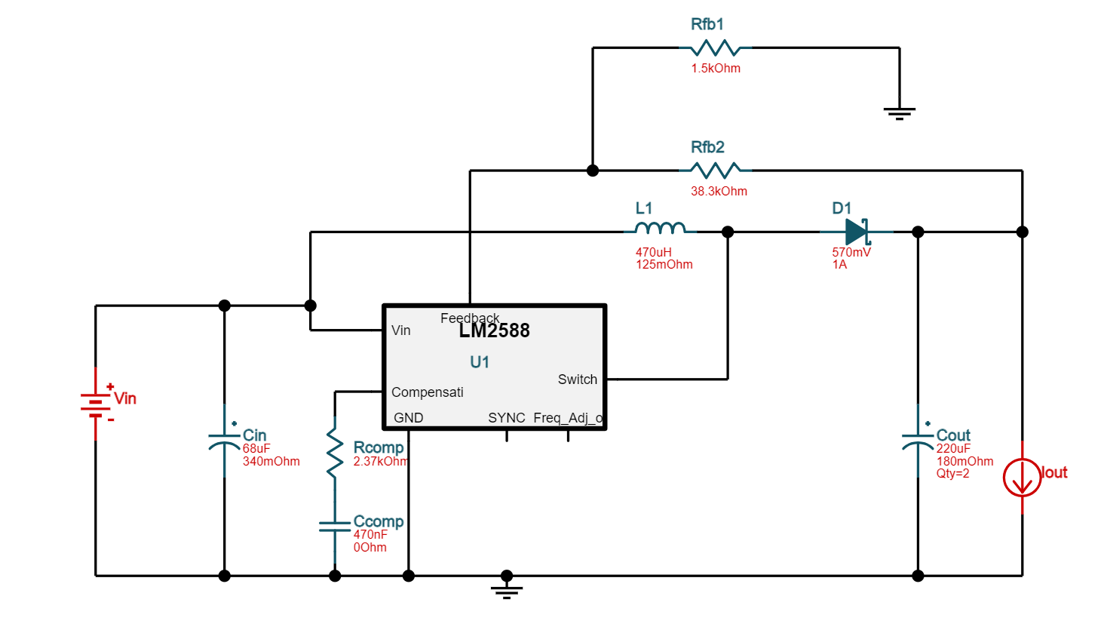
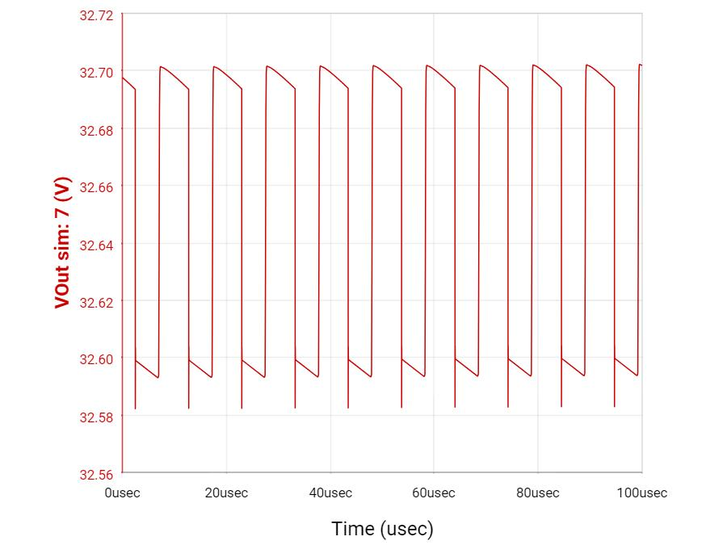
Boost Converter

Slide 7
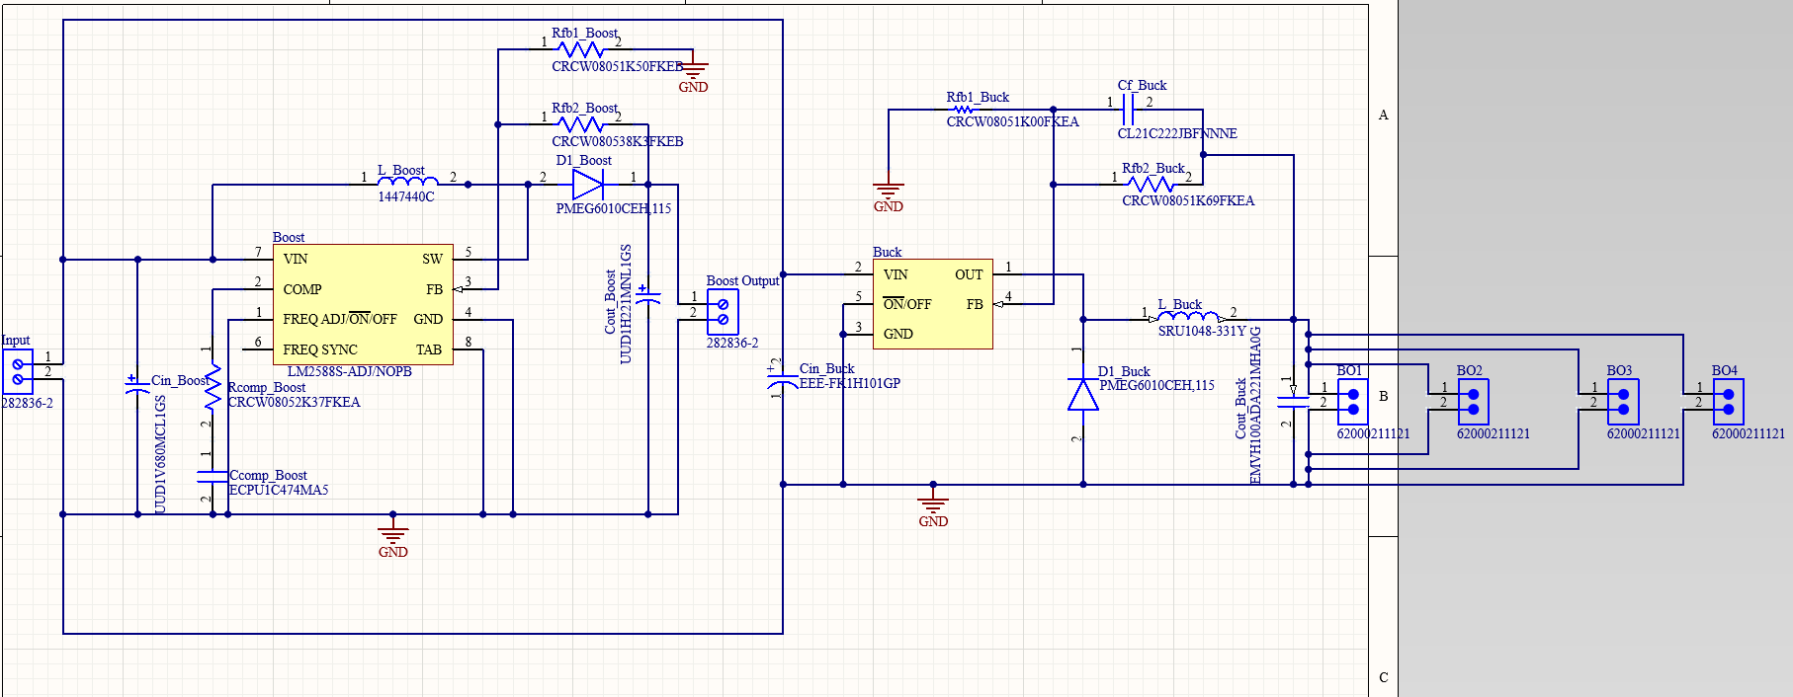
Altium Schematic

Slide 8
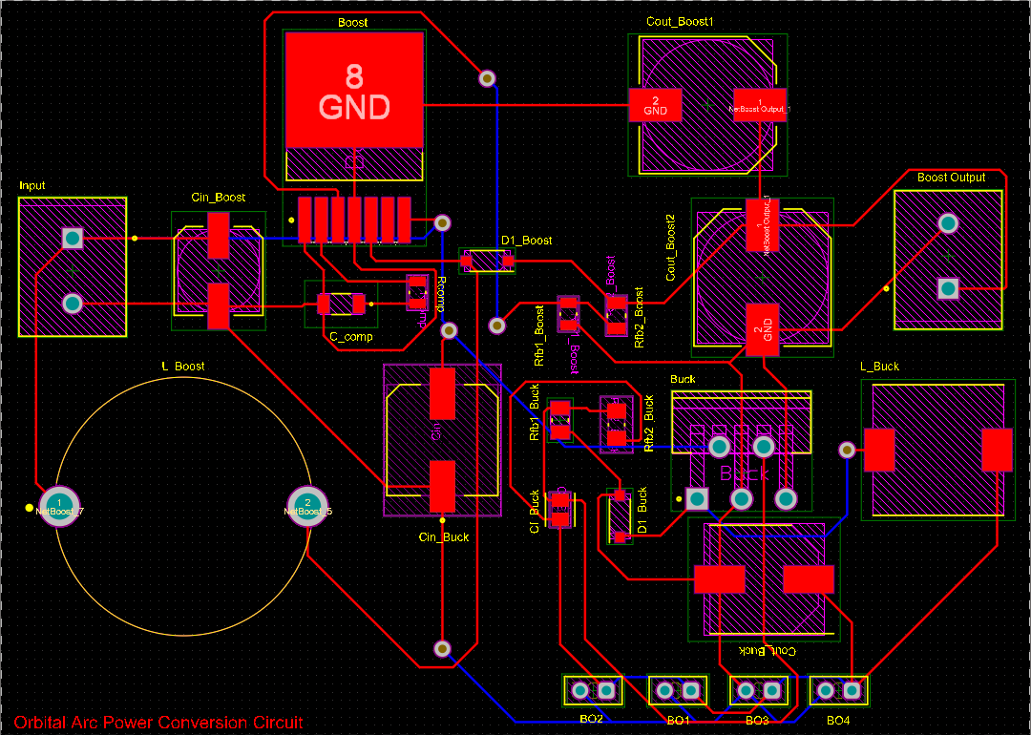
Altium PCB Design

Slide 9
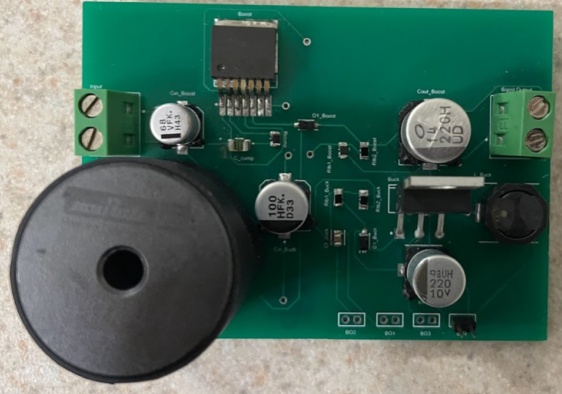
Soldered PCB

Slide 10
Validation Plan
Max Power | Measure power for each component ensuring below power budget of 50W | - | Alejandro Torres
Voltage Supply | Voltage supply is 24 V | Completed | Alejandro Torres
Microcontroller Supply Voltage | Microcontroller is supplied a voltage of 3.3V/5V | Completed | Alejandro Torres
Thermionic Cathode Supply Voltage | Supplied Voltage between 3-6V | Completed | Alejandro Torres
Ionizer Chips Supply | 33V Supplied | In Progress | Alejandro Torres
Output Voltage | Measure output voltages to be supplied for each component | Completed | Alejandro Torres
PCB Design | Width & Length : <10cm Height: <2cm | Completed | Alejandro Torres
Arc Pulse Generator | Goes from 3-6V to 100kV | In Progress | Alejandro Torres

Slide 11
Remaining Tasks
100kV Arc pulse generator tested
PCB debugged with boost converter working
Integration with other subsystems in 404

Slide 12
Microcontroller Design Accomplishments
Microcontroller PCB designed and ordered.
All parts necessary for PCB ordered.
Peripherals for microcontroller mostly configured.

Slide 13
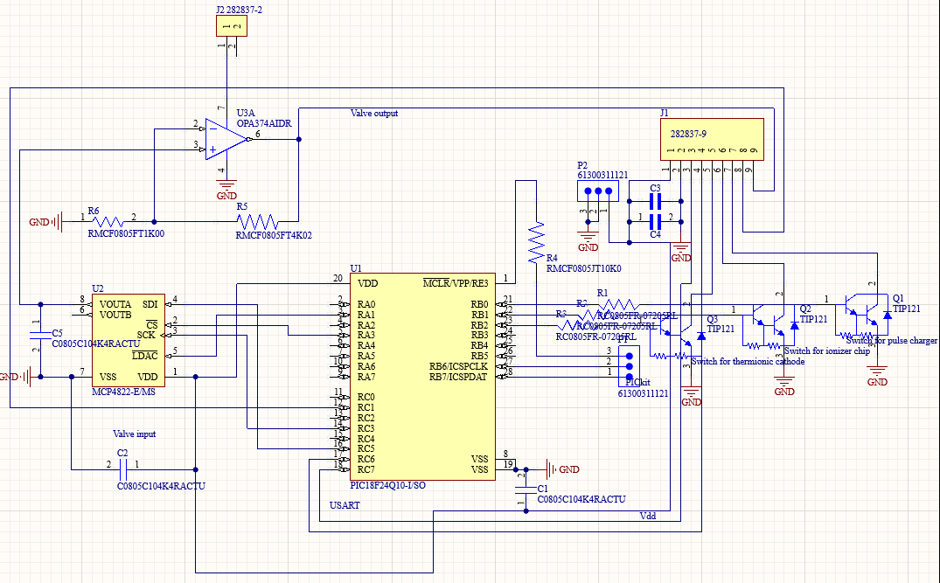

Slide 14
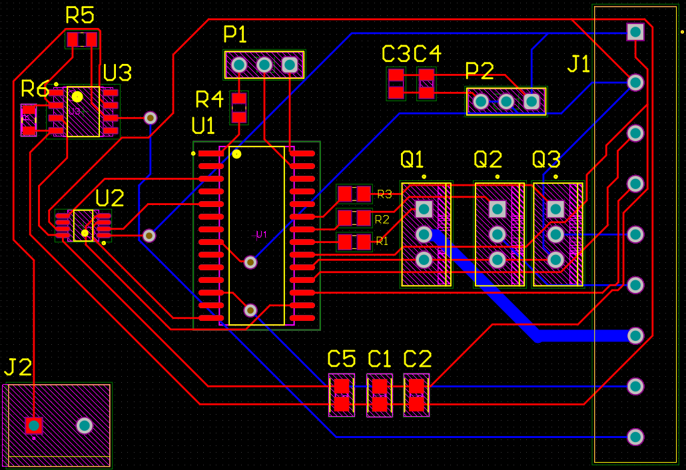

Slide 15
Microcontroller Validation Plan
5.3 Signal Interfaces | Fuel Valve | Verify microcontroller compares and regulates fuel pressure and flow. | - | Joshua Feldman
5.3 Signal Interfaces | Microcontroller | Verify microcontroller properly activates pulse charger, ionizer, and thermionic cathode. | - | Joshua Feldman
5.3 Signal Interfaces | Microcontroller | All connections to the microcontroller are properly set up. | - | Joshua Feldman
6.1 Prototype Interface | Microcontroller | Microcontroller can be tested with test bench | - | Joshua Feldman
6.1 Prototype Interface | Microcontroller | BIT system properly catches exceptions thrown. | - | Joshua Feldman

Slide 16
Remaining Tasks
Finish coding for microcontroller
Solder the PCB when it arrives
Test the board to ensure that the code functions
Integrate microcontroller and power PCBs in 404
Fuel supply valve integration in 404

Slide 17
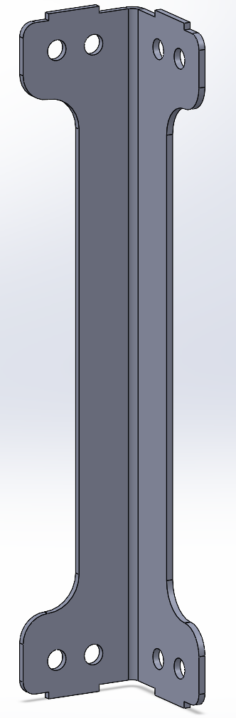
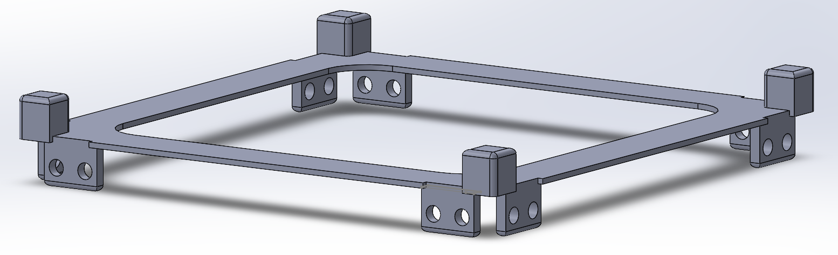
CubeSat Chassis Accomplishments
Completed CAD for corner and top pieces
Engineering drawings completed
Meeting with FEDC Machinist 11/14

Slide 18
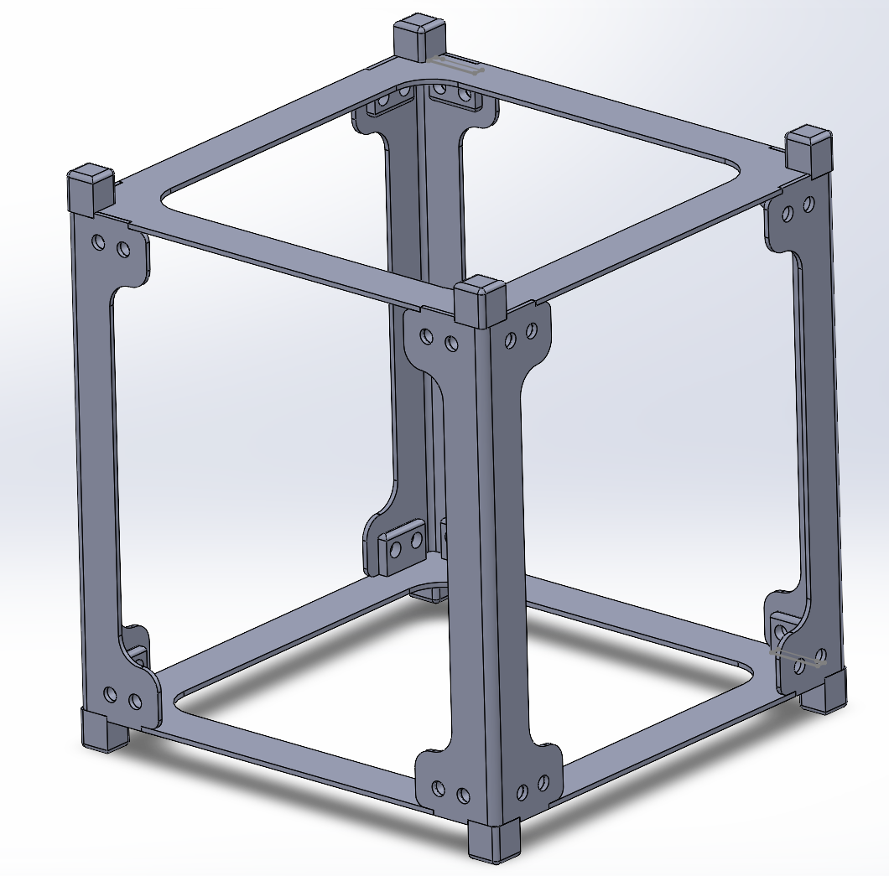
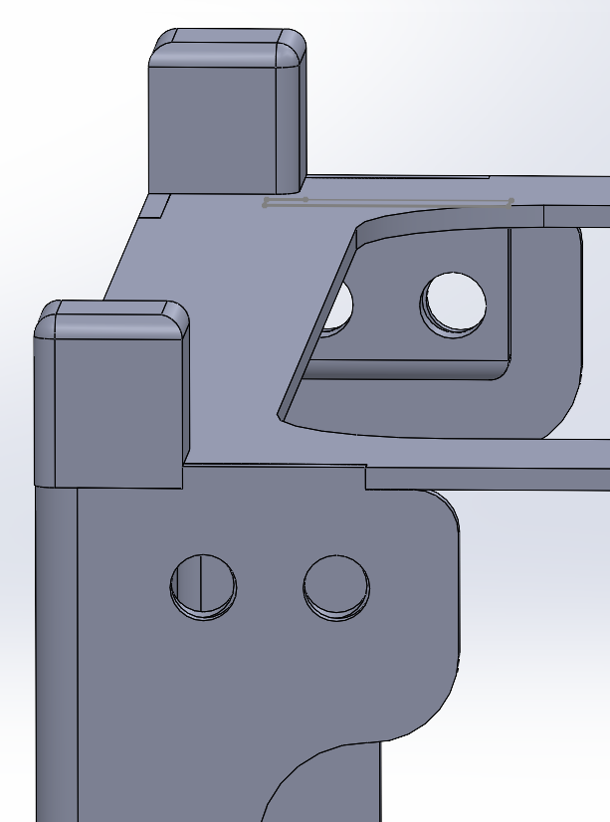

Slide 19
CubeSat Chassis Validation Plan
3.2.2.2 Volume Envelope | Prototype Footprint | Footprint of our prototype fits CubeSat size regulations (10x10x10 cm) | - | Ian Poynter
3.2.2.1 Mass | Prototype Weight | Weight of the Chassis does not exceed 1 kg on its own | - | Ian Poynter
3.2.2.3 Mounting | Electronics Mounting | Power Supply and Microcontroller PCB has space for mounting to the chassis | In Progress | Ian Poynter
3.2.2.3 Mounting | Accelerator Plate Mounting | Mounting for accelerator plate is available and not blocked by other components | In Progress | Ian Poynter
3.2.2.2 Volume Envelope | CubeSat Regulations | The prototype chassis fits all CubeSat standards not neglected due to design restraints or to be tested in the future | - | Ian Poynter

Slide 20
Remaining Tasks
Construction of chassis
Fabrication of parts
CubeSat Standard Verification
Chassis assembly
For ECEN 404
Mounting of plates and integrated PCB
Risk calculations and any chassis modifications

Slide 21
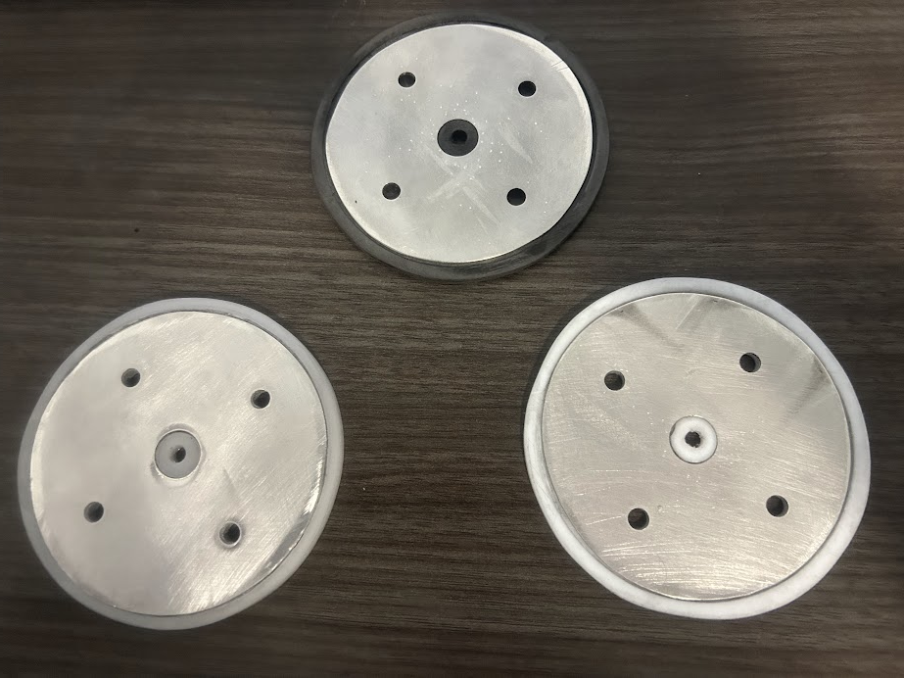
High Potential Accelerator Plate
Completed fabrication for circular-plate geometry.
Drawings for plates of remaining shapes are completed and under fabrication.

Slide 22
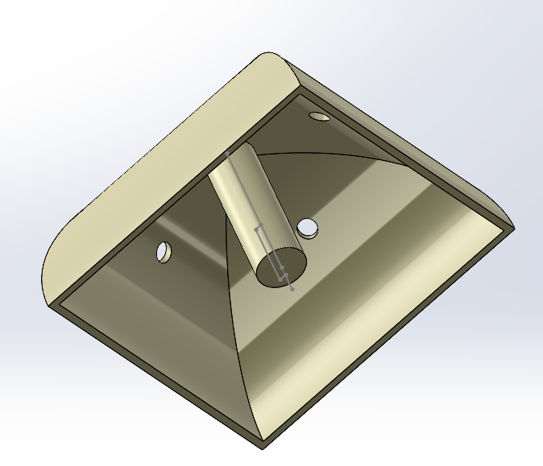
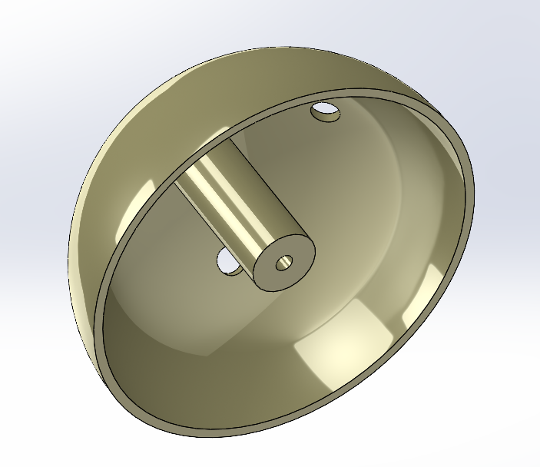
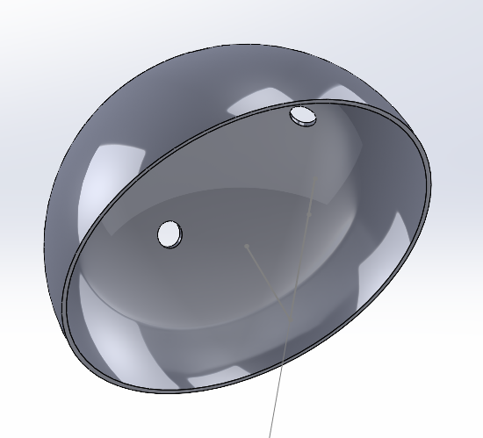
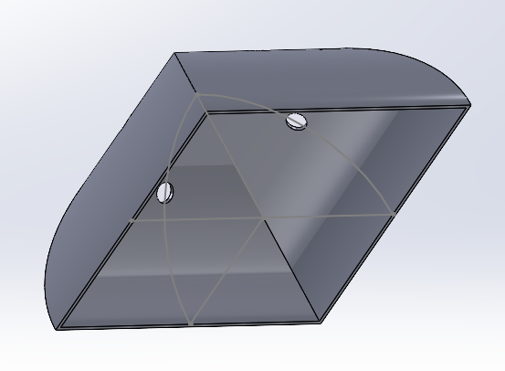

Slide 23
Validation Plan
3.2.2.4 Accelerator Geometry and Material | Geometry (Volume) | Accelerator will have around similar volume as desired volume (10 cm x 10 cm x ~2cm) to fit inside chassis | Complete | Michael Kim
3.2.2.4 Accelerator Geometry and Material | Geometry (Shape) | 3 geometries will extend retention without additional charging and protect spacecraft/ionizer from it | Complete | Michael Kim
3.2.2.4 Accelerator Geometry and Material | Material | 3 materials that handle space launch, radiation stress, and electric flux from space plasma will be tested | Complete | Michael Kim
3.2.2.4 Accelerator Geometry and Material | Combinations | All 9 combinations will be constructed for testing for electrostatic potential. | In Progress | Michael Kim

Slide 24
Remaining Tasks
Construction of the hemisphere and parabolic pyramid plates.
Fabrication of metal and plastic material layers.
Assemble layers.
Tasks for 404
Calculate electrostatic potential for each material-geometry combination.
Choose one combination that best follows our calculations and guidelines.
Mount chosen combination to RIOT Drive

Slide 25
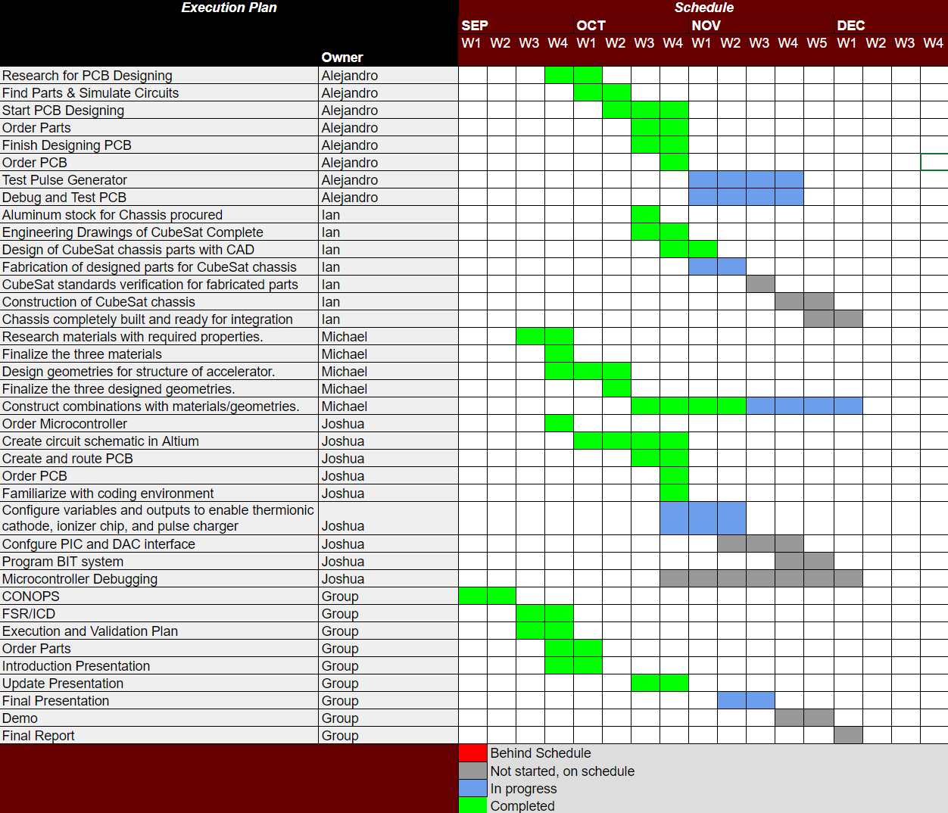
Execution Status

Slide 26
Questions?

